Slide 2







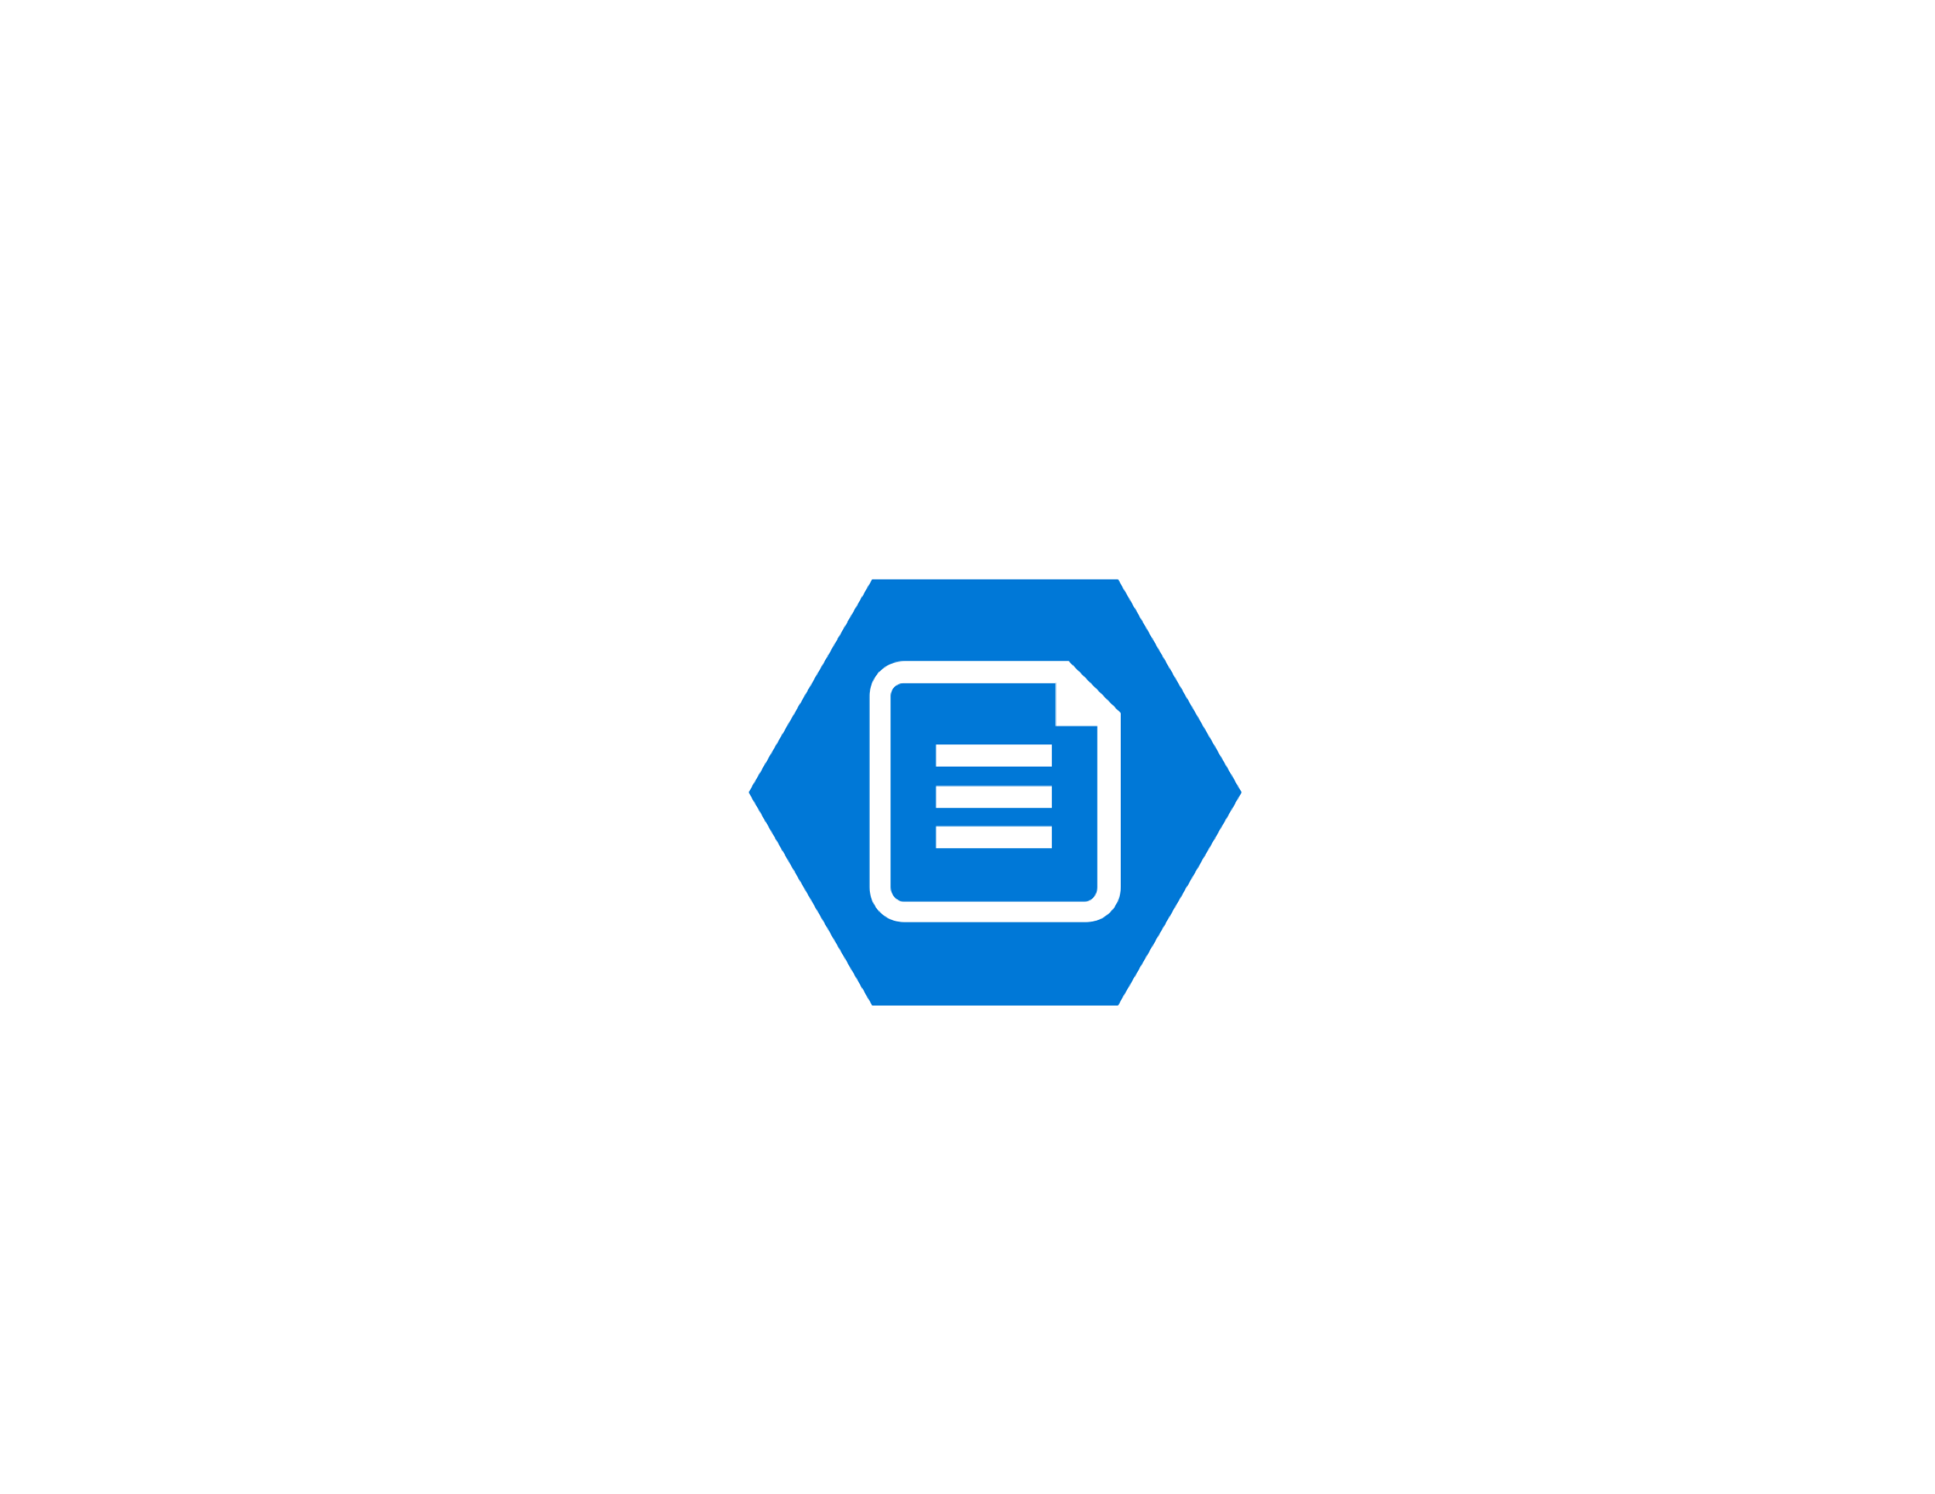
Public IP
Public IP
Resource Group
Virtual Network
Load Balancer
(Application Gateway)
Bastion
ACS 6.1
ACS 6.1
Active MQ
Transform
Service
Transform
Service
Content Store
(NEW Alfresco Azure Connector)
Availability set
Transform router
Transform router
Active MQ
Imagemagick
Imagemagick
Libreoffice
Libreoffice
Availability set
Pdf-renderer
Pdf-renderer
Tika
Tika
Shared File Store
Shared File Store
Search Services
Search Services
Availability set
(Azure Files)
Availability set

